Slide 1

Restaurant Recommendation Using Yelp Reviews
Kausar Perveen | Sohan Puthran| Shouvik Sharma| Rahul Nair | Cheng Jiang

Slide 2
Agenda
1. Problem Statement
2. Data Preparation & Data Cleaning
3. EDA
4. Models
5. Lessons Learned and Future Plans
6. Deployment
7. Questions

Slide 3
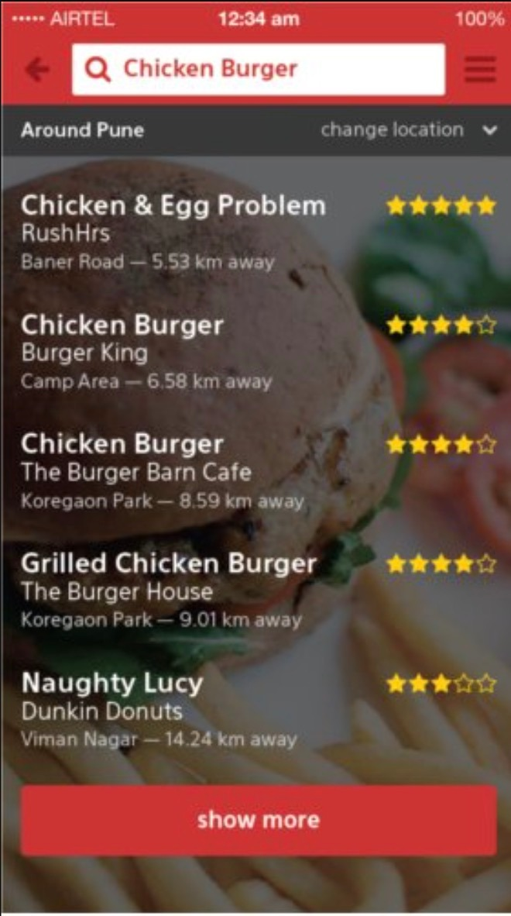
Problem & Vision
In terms of restaurants, there are too many options available for people to choose from based on their preferences.
It's always difficult for new visitors, even locals, to find the ideal restaurants that are exciting and novelty.
We aim to build a personalized prototype of restaurant recommendation system, which not only considers the interaction between customers and restaurants, but also contains metadata representing customers' personal taste and restaurant functions.

Slide 4
Project Goal

Slide 5
Technologies Used
Natural Language Processing
Angular 8
Flask

Slide 6
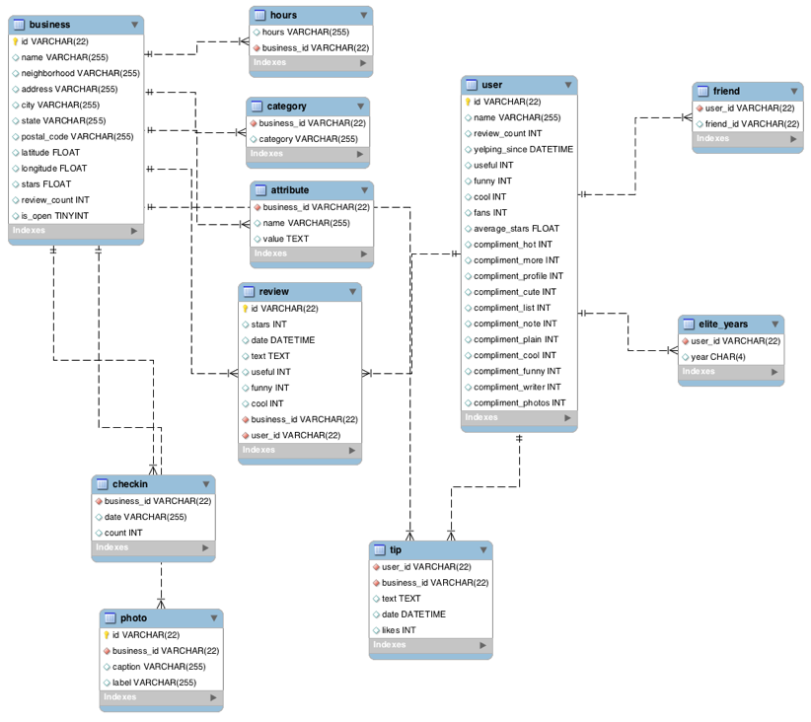
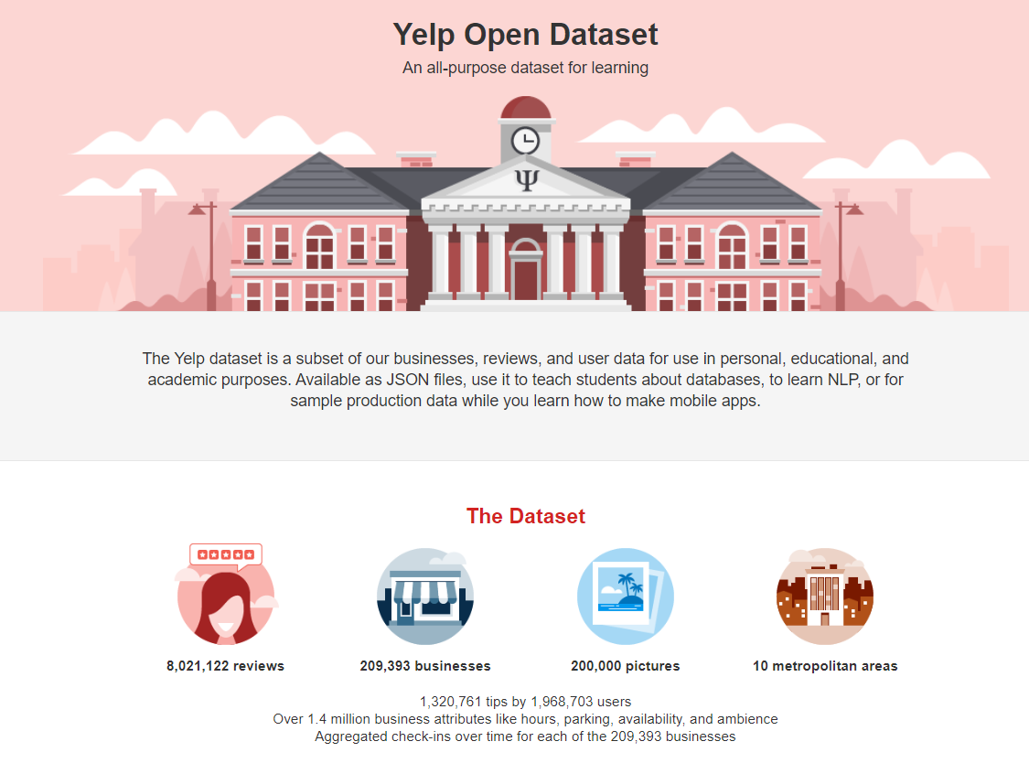
Datasets
Primary Dataset :-
Datasets are acquired from the official website of yelp
We are using following datasets :-
User.json
Review.json
Business.json
Secondary Dataset :-
We have acquired median income for each zipcode for the year 2019, and mapped to restaurants

Slide 8
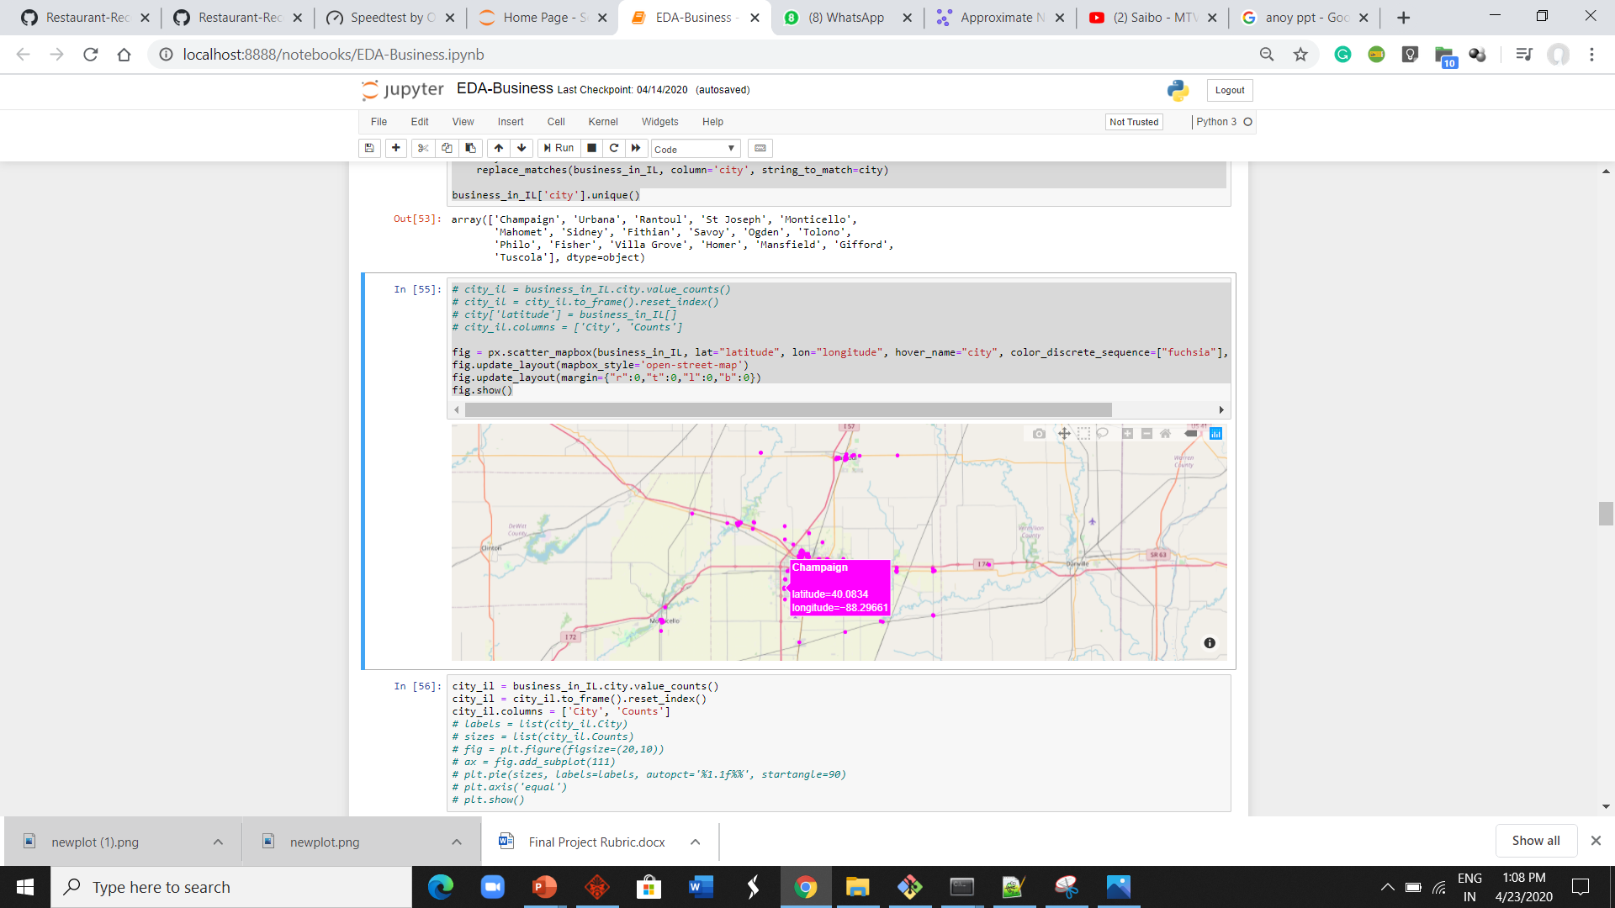
Data Preparation
Business
Businesses with open = 1 tag were only considered
We have taken into consideration restaurants in the state of Illinois.
‘Attributes’ column in the dataset was extrapolated to create new features

Slide 9
Data Cleaning
1. column value extraction:- Extracted values (such as cuisine type, theme, etc.) from the category column of business data. Since we were creating a recommender system for restaurants in Illinois, we extracted records of restaurants in Illinois only.
2. Null Values:- There were lot of columns with null values, mainly in the columns which were extracted from the category column, so we removed those columns which had null value count more than 300.
3. Duplicate Record:- In Users data, there were lot of users who gave multiple reviews to the same restaurants. For that, we kept the most recent one and removed the others.

Slide 10


Data Cleaning
Business
Spelling Correction for the City variable
Standardize the Date format of Hours variable
Remove redundant Categories
User
Standardize account age by years
Check the missing values

Slide 11
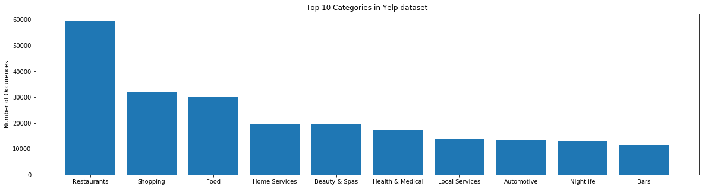
Exploratory Data Analysis
Business: Distribution of businesses in Illinois
The yelp dataset consists of variety of different businesses indicated by the column
Number of entries for the category ‘Restaurants’ was the highest.
Notes:
Mention that ### There are 1301 categories. We shall check top 10 categories.

Slide 12
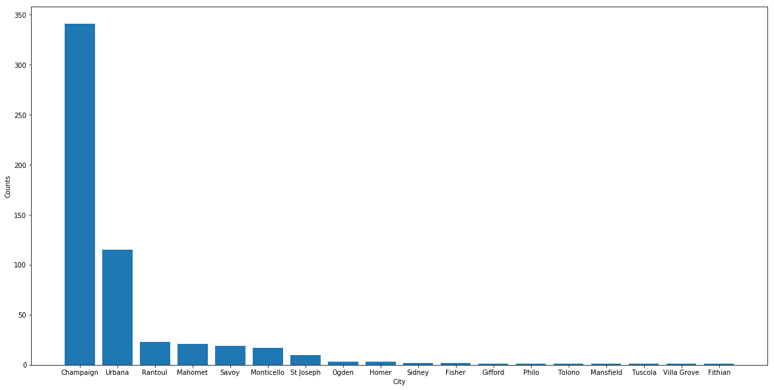
Exploratory Data Analysis
Business: Distribution of restaurant business in Illinois
Notes:
- We cannot state Illinois exploration in eda, we can call it in data preparation after we have declared that we will be focusing on illinois

Slide 13
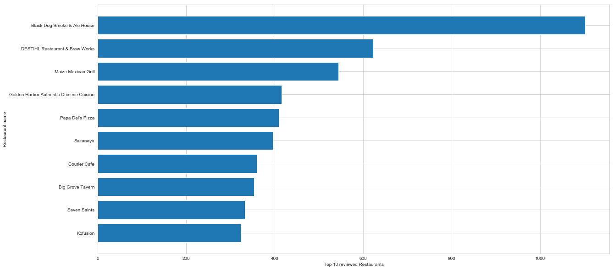
Exploratory Data Analysis
TOP 10 MOST RATED RESTAURANTS IN ILLINOIS
Notes:
- We cannot state Illinois exploration in eda, we can call it in data preparation after we have declared that we will be focusing on illinois

Slide 14
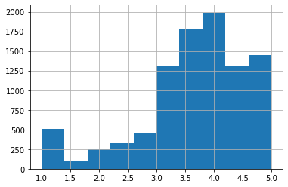
Exploratory Data Analysis
HISTOGRAM OF AVERAGE STARS FOR ILLINOIS USERS

Slide 15

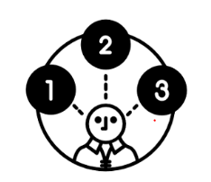
Models
A Recommendation System refers to a system that can predict the future preference of a set of items for a user
restaurant functions.zz
Following are the models which we used:-
Singular Value Decomposition (SVD)
Approximate Nearest Neighbors
Collaborative Filtering
Hybrid Matrix Factorization
Notes:
We aim to build a personalized prototype of restaurant recommendation system, which not only considers the interaction between customers and restaurants, but also contains metadata representing customers' personal taste and
We didn’t use Content based filtering because it doesn’t consider interactions between users and items which can open up new options for users other than it’s past choices.

Slide 16
Models
Singular Value Decomposition:-

Slide 17
Models
Approximate Nearest Neighbors:-
Retrieves a ‘good guess” of the nearest neighbor. For that, the algorithm doesn’t guarantee to return the actual nearest neighbor in every case, in order to improve speed or save memory.

Slide 18
Model

Slide 19
Model

Slide 20
Results

Slide 21
Results

Slide 22
Lessons Learned
How recommendation systems works
Web Scraping
Data Cleaning is not easy
Extracting insights from data

Slide 23
Future Plans
Location based recommendations
Expand the system for the entire country
Build a complete website for the system
Take user inputs and update the database

